Slide 1
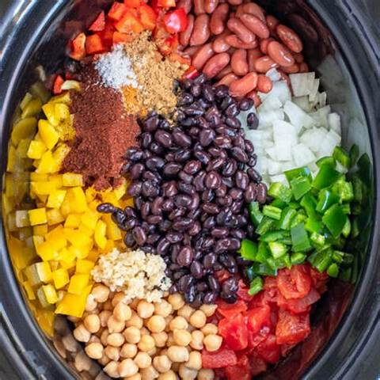
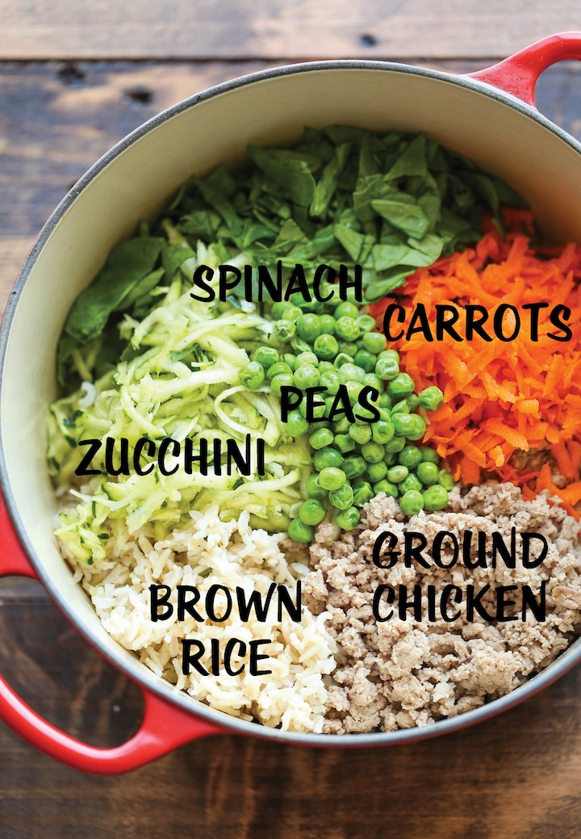
Food Recipes

Slide 2
Team Lead : Mohan Kumar B C
Front-end Lead : Deepak Singh
Back-end Lead : Sai Kumar Pandi

Slide 3
GROUP MEMBERS
FRONT END
BACK END
Pratik Bhange
Deepak Kumar Singh
Supriya S
Kodavati Priyanka
Mohan Kumar B C
Abbi Reddy Prem Kumar
Penty Pranay
Pandi Jai Sai Kumar
Abhiraj Ashok Pekhale
Shweta Sanjay More

Slide 4

INTRODUCTION
A recipe is a set of instructions that describes how to prepare or make something.​
A recipe is to have a precise record of the ingredients used, how much amount of ingredients are needed and the way they are combined.

Slide 5
ABSTRACT
The main objective of our application is to create a dynamic and responsive Java application to allow a user to register to the application and search for recipes online.
This application helps genuine food lovers to explore and have wonderful experience with the recipes uploaded.

Slide 6
TECHNOLOGIES USED
Front-end : Angular​
Server-side: Spring Boot​
Back-end: MYSQL, Hibernate​
Server: Tomcat

Slide 7
MODULES OF THE PROJECT
ADMIN MODULE
USER MODULE

Slide 8
ADMIN
Admin will be able to :
Login to the portal.
Admin can add / remove or even endorse a recipe.
Edit recipe details like name, item details, ingredients and cooking steps.

Slide 9
ADMIN FLOW
ADMIN
LOGIN
VIEW RECIPES
EDIT RECIPE
ADD RECIPES
REMOVE RECIPES
LOGOUT

Slide 10
USER
User will be able to :
Register to the application.
Sign in to the application.
Search for recipes based on the search keyword.
Can see selected recipe details.
Can also like and comment on the item recipe.

Slide 11
USER FLOW
USER
RESISTER
LOGIN
VIEW ALL RECIPES
SEARCH RECIPES
LIKE
LOGOUT

Slide 12
USE CASE DIAGRAM(ADMIN)
APPLICATION
LOGIN
ADD/DELETE RECIPE
DATABASE
EDIT RECIPE
REFRESH
ADMIN
LOGOUT

Slide 13
USE CASE DIAGRAM(user)
APPLICATION
REGISTER
VIEW ALL RECIPE
DATABASE
SEARCH RECIPE
VIEW SELECTED RECIPES
USER
LIKE

Slide 14
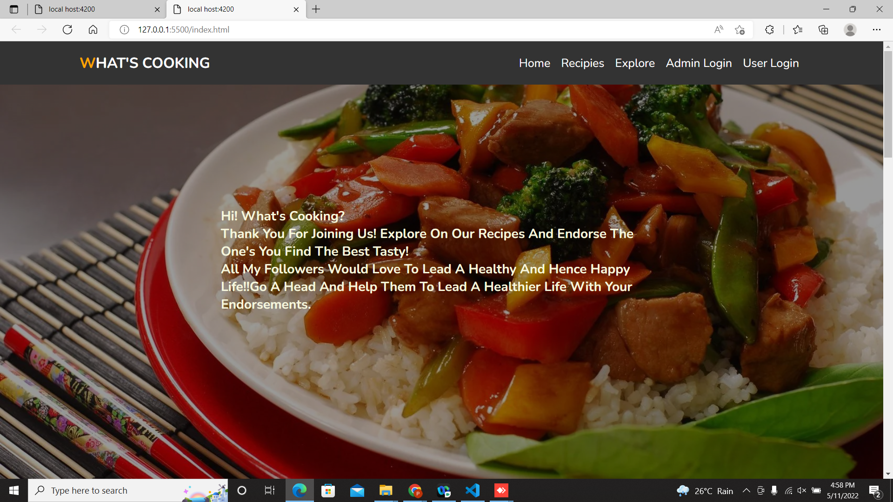

Slide 15
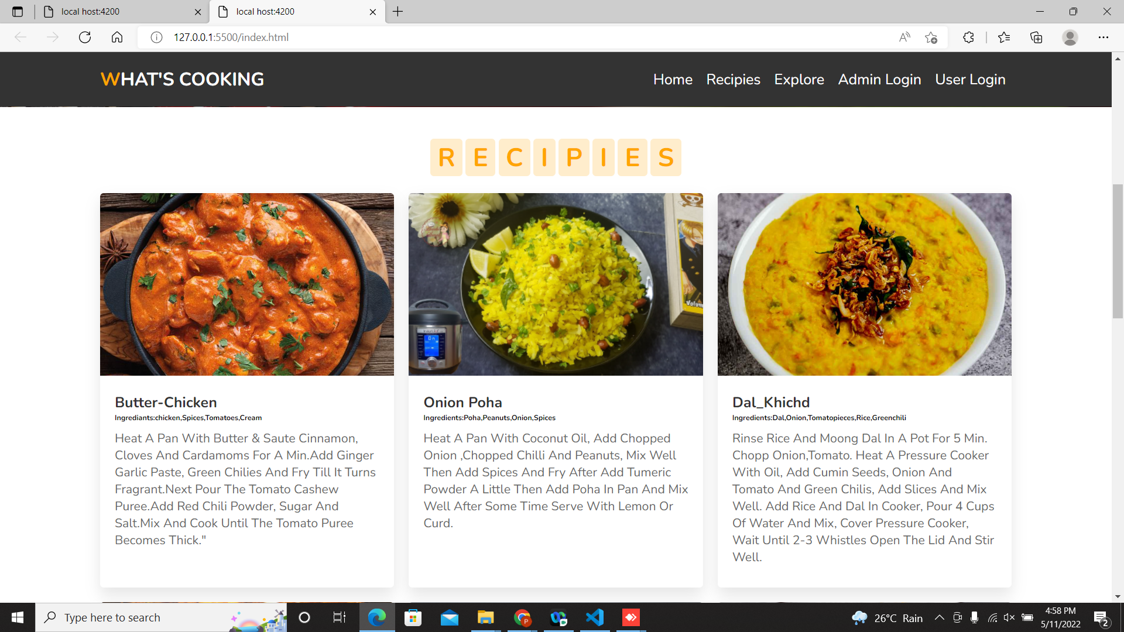

Slide 16
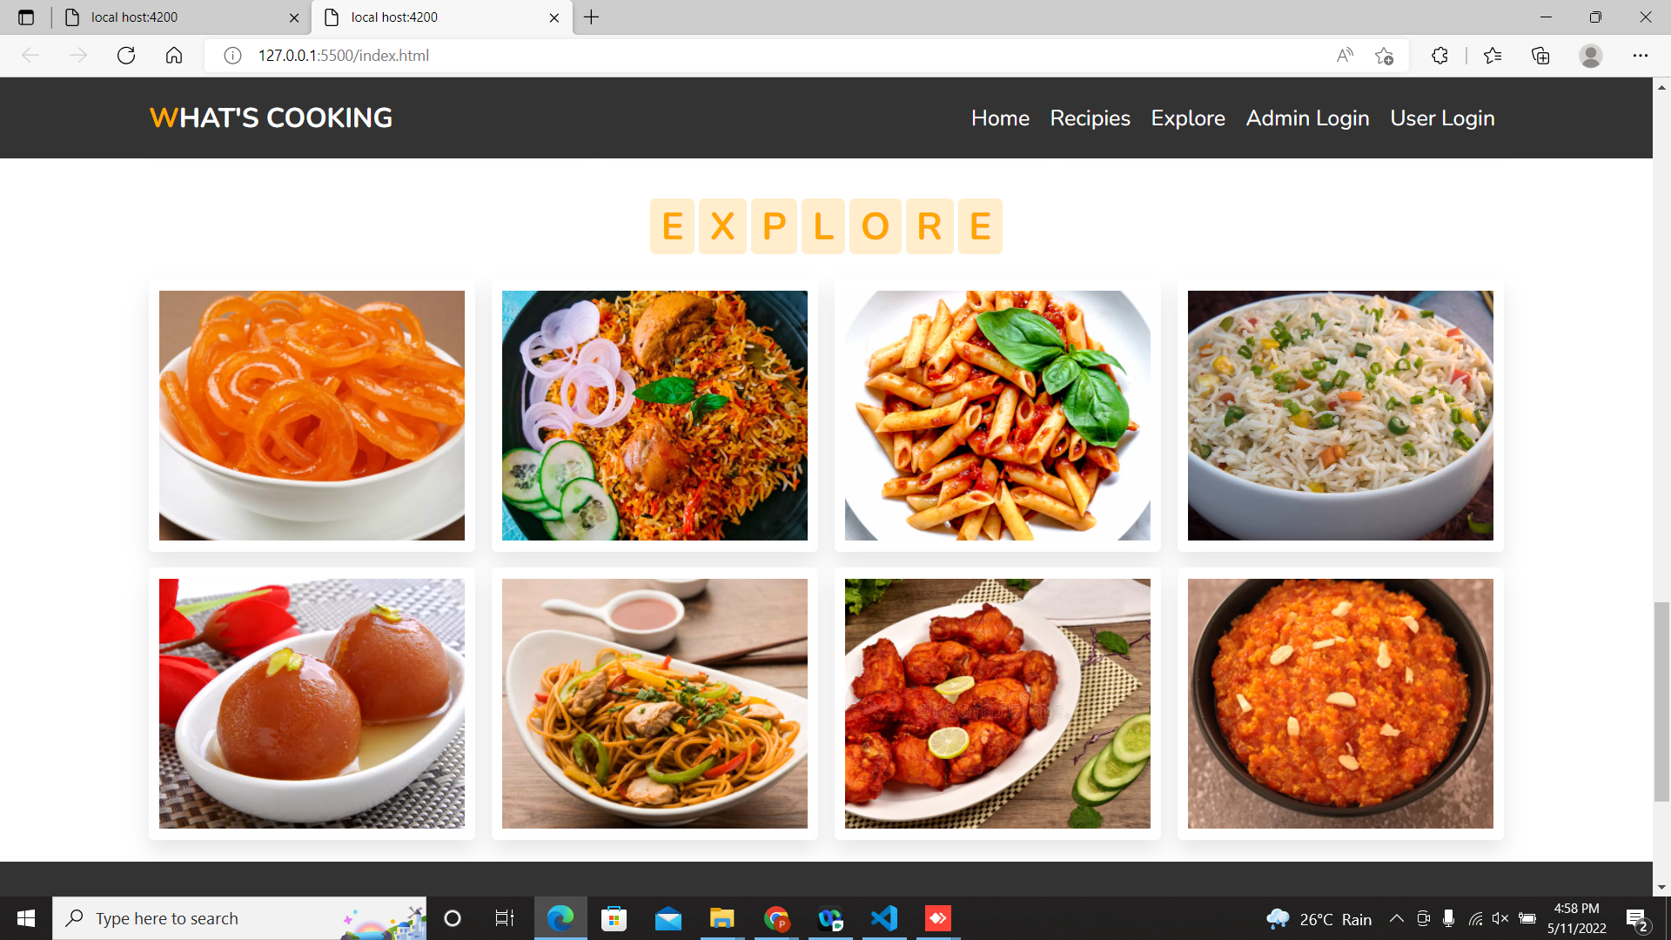

Slide 17
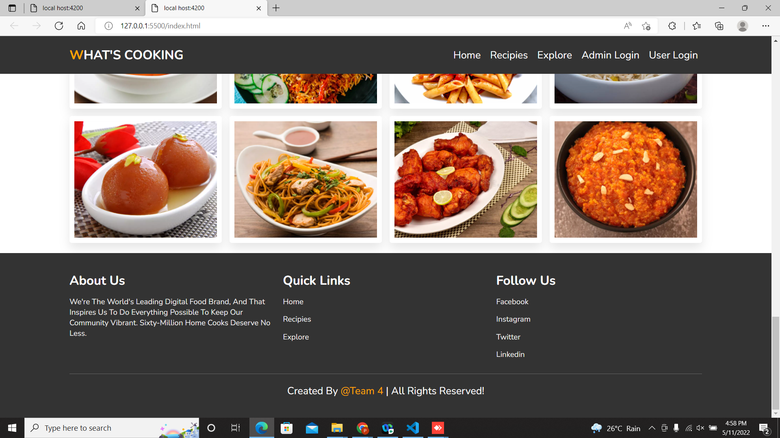

Slide 18
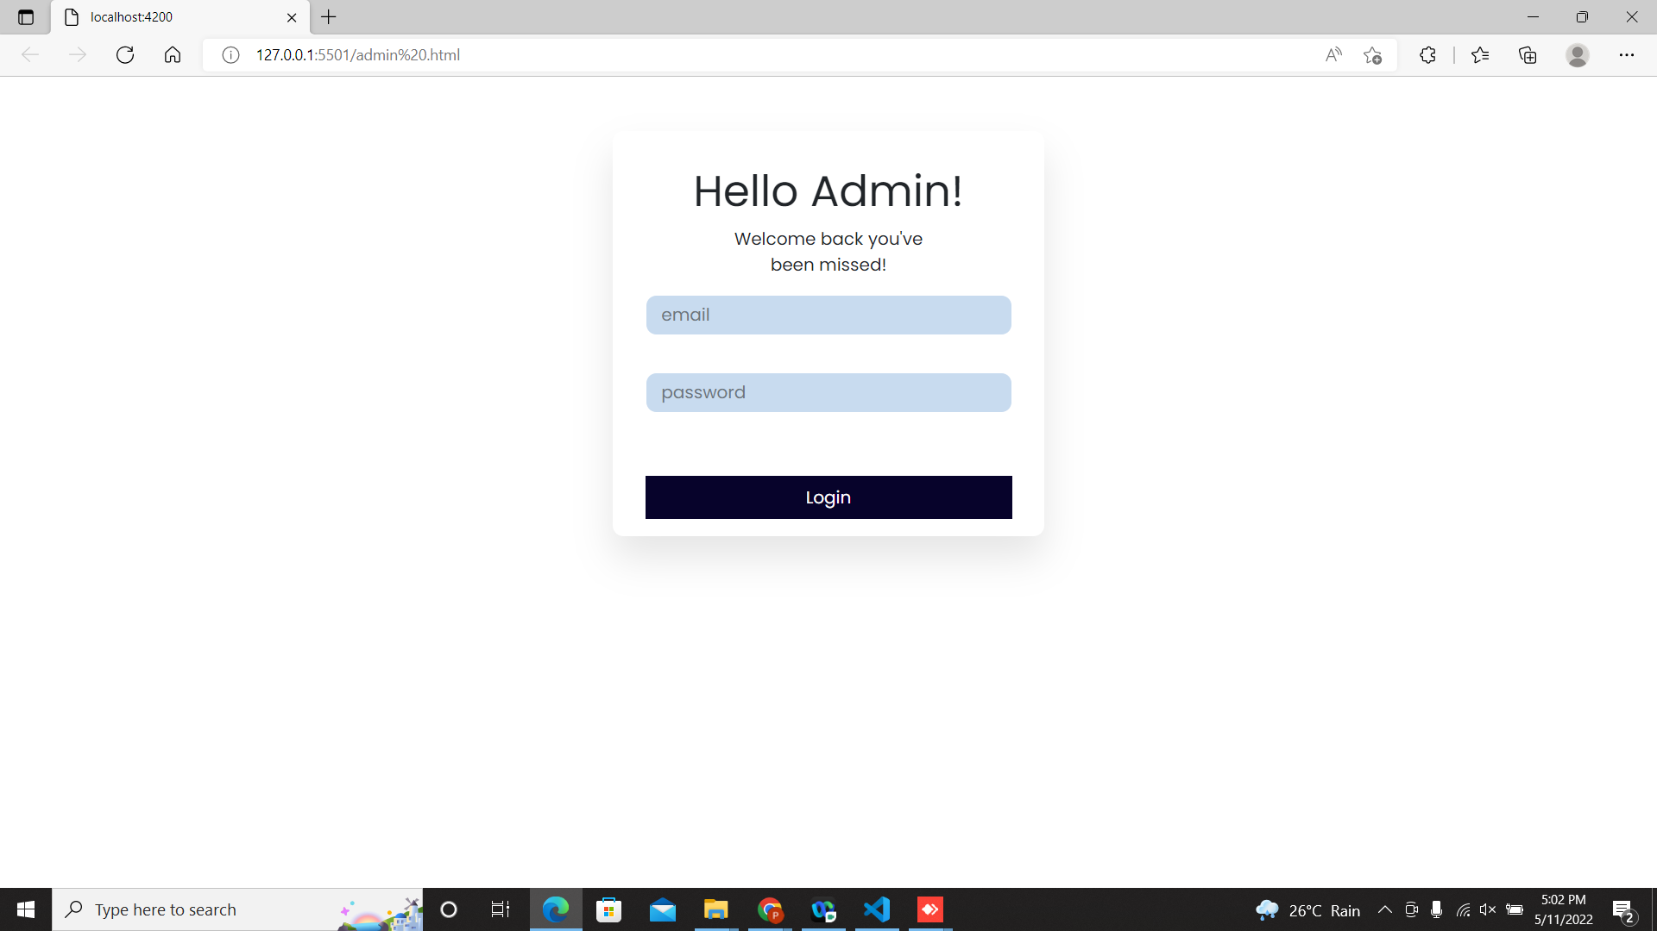

Slide 19
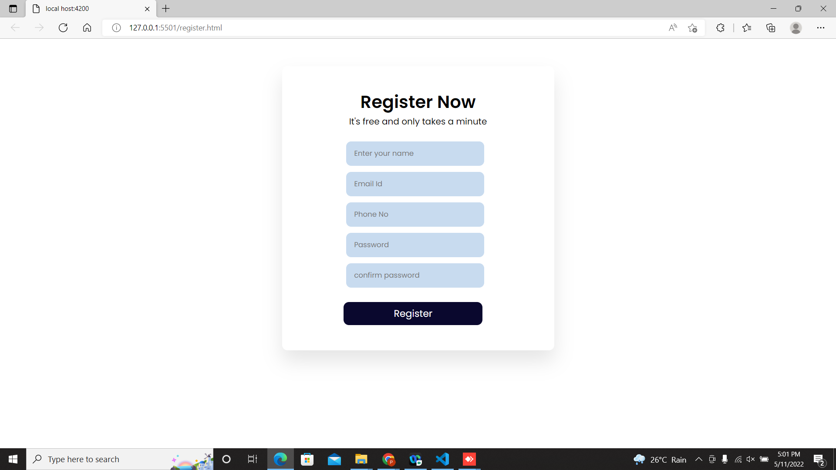

Slide 20
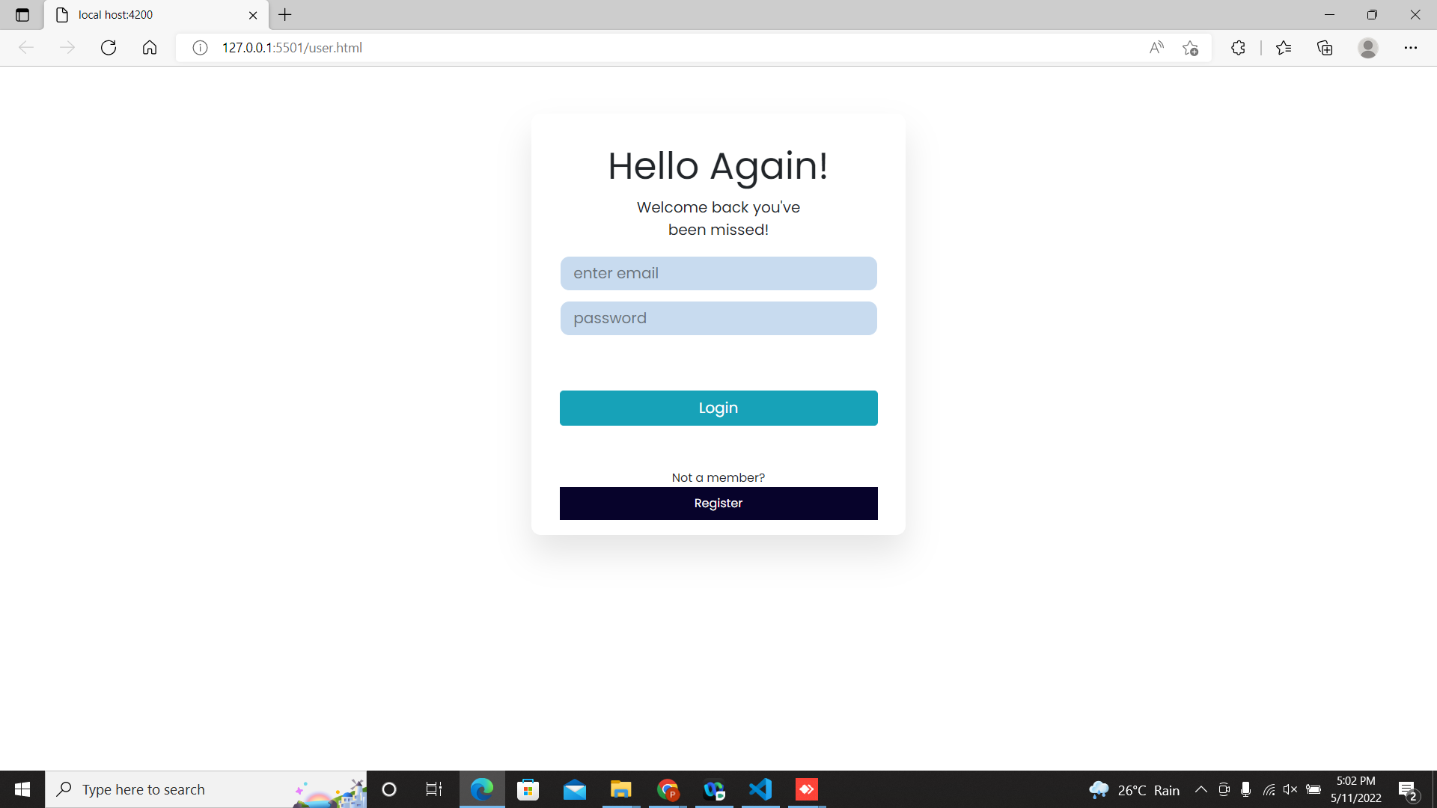

Slide 21
ADVANTAGES
Search for recipes based on the search keyword like item name, item description.
User will be able to sort results based on different categories of the food items.
It ensures the privacy of the users data and secures its access in the database and the maintenance of the application is also easy.

Slide 22
FUTURE SCOPE
Add more user interface feature.
Promotional offer.
Commercialize the web app.

Slide 23
CONCLUSION
The main objective of the application is to understand the concept and implementation of Java, Spring Boot, Databases and Angular technology.
Our project helps the users to easily find out their choice of taste and recipe.

Slide 24
Thanks for Listening with great patience

